Slide 1
USAA P&C Chatbot (POC & POT) presented by : Arghadeep Chaudhury & Dilip Pani IBM Confidential

Slide 2

Problem Statement
CWH Tracker, Policy System of Record, Claims System of Record, Common data elements tracker, Wiki, BOX, Shared Location etc. Scrum Master, Team Lead, DPO, SDAR Team, IT Team, GW Team, Person X, Person Y etc. I want the see the details for Loss amount, how do I find that details? I don't have access to CWH tracker, how to find some information from that file? I know partial business attribute name ( i.e. FNOL) , where to find lineage information? Can I get a lineage information in excel format for particular data elements? Based on Legacy Data Mart column name how do I get Information Model details? I am doing physical data model how do I get the Information Model details? Can I find Info model details based on CWH column name? Where should I get the Claims Mapping document? How to find legacy transformation logic for Total Loss amount? I am from Policy team how I get some lineage information for one common data elements? When it comes to data related queries ( i.e. source info, target info, data lineage, mapping etc.) from employees they are lost with so much scattered information, and which leads to frustration of not getting right advise/information. In the last few years there are significant changes in terms of process, guidelines and tools/tech. associated with them. Many People not aware of all the process or recent changes hence unable to provide right guidance/information to practitioners. People's role and program didn't success due to misalignment or lack of knowledge.

Slide 3




config.yml
P&C Modernization Chatbot
Wiki Pages
nlu.yml
AI Model
domain.yml
CWH Sheet
Training Data Extractor
(Automation process)
rule.yml
SOR Sheet
ML Engine
story.yml
* USAA Change & Feedback

Slide 4
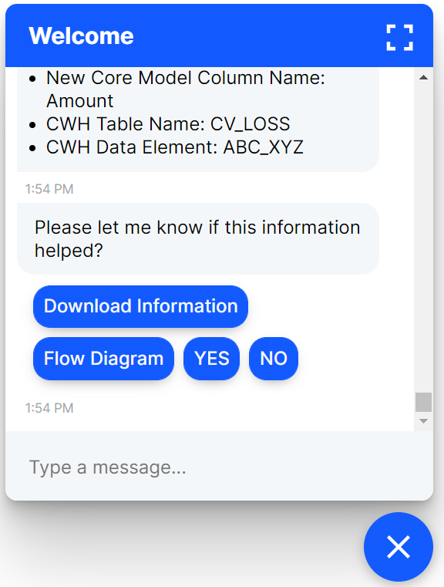
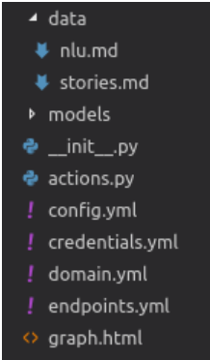

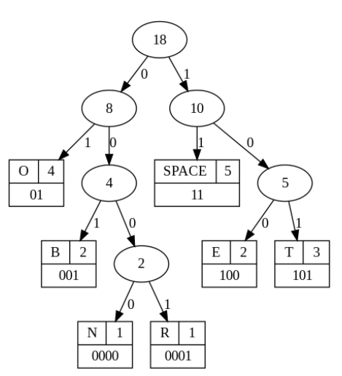
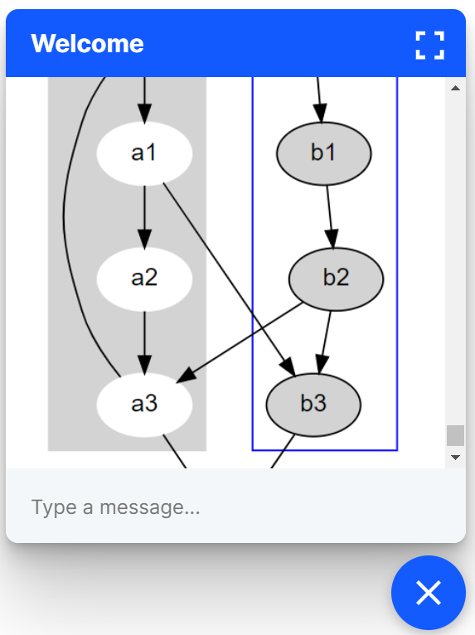
RDBMS
(Database)
BOT ENGINE
eralchemy
graphviz
Dynamic Lineage Generation on Server

Slide 5
Additional Slides on RASA as Framework!

Slide 6
Bot Framework with : RASA
About RASA:
Rasa supplies conversational AI infrastructure for a global community of developers, providing the tools to build chat-based contextual assistants.
Rasa is powered by open source and machine learning framework for building AI assistants' software and runs in production across industries like healthcare, financial services, retail, and insurance.
Rasa support any programming language experience although custom operations need to write in Python.
Link : https://rasa.com/
Insurance industry with rasa example : AXA insurance
Packages needed for RASA to Onboard :
Rasa python library :https://pypi.org/project/rasa/ needs to be included in USAA python nexus repository.
Quick Installation Steps:
C:\> python3 -m venv ./venv
C:\> .\venv\Scripts\activate
pip3 install -U --user pip && pip3 install rasa
And We are now ready to go!
Additional library needed for this solution is – eralchemy with Graphviz installed for generating runtime diagrams and graphs.

Slide 7
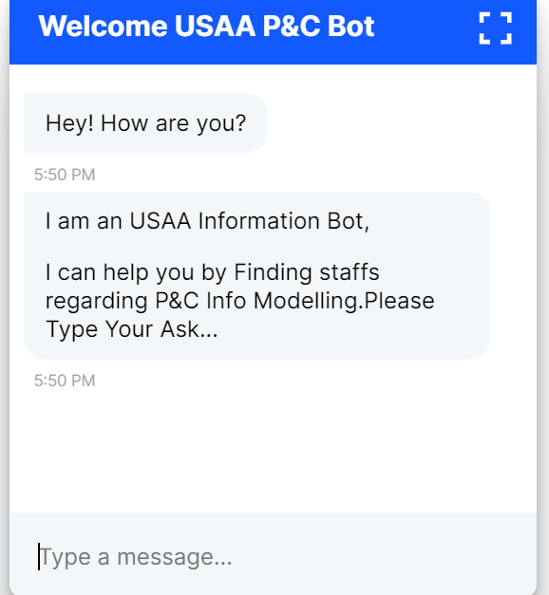
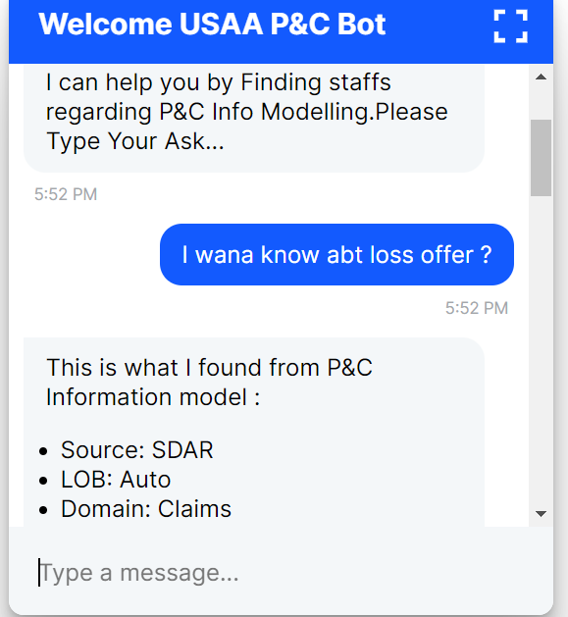
Screen Shots from DEMO
1
2

Slide 8
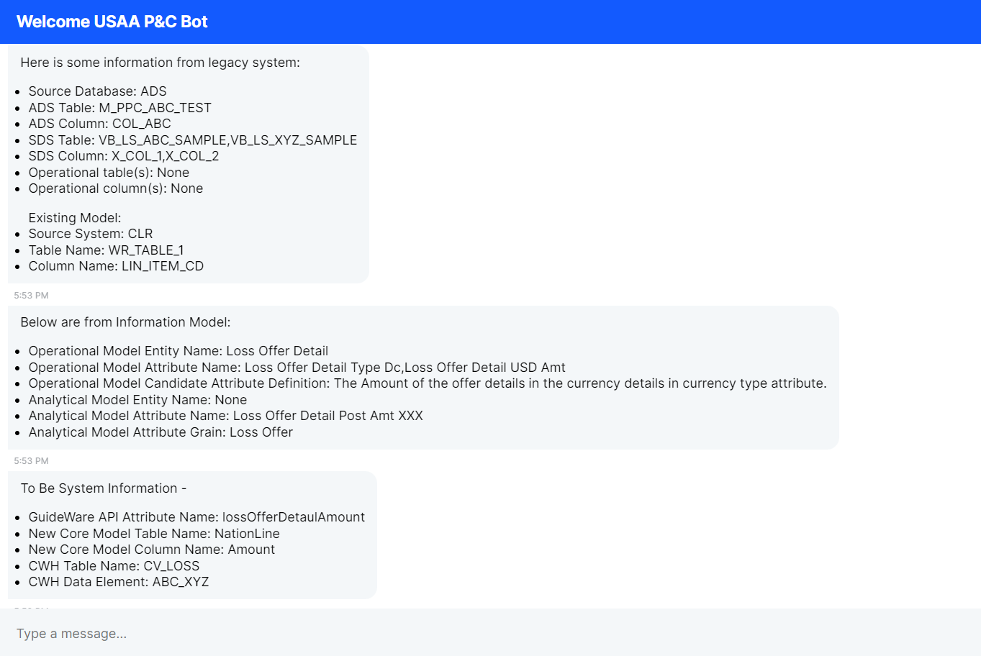
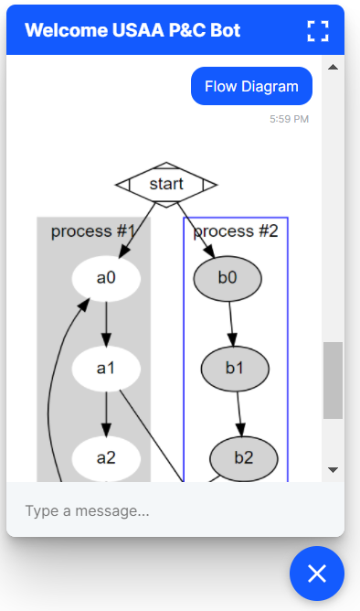
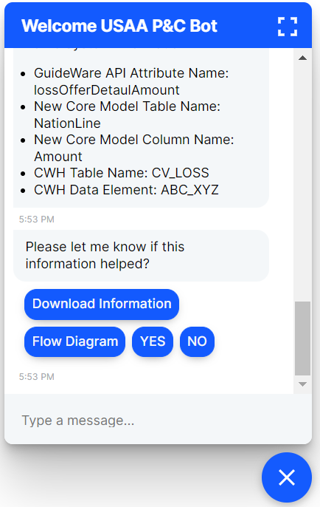
4
5
3

